Slide 1
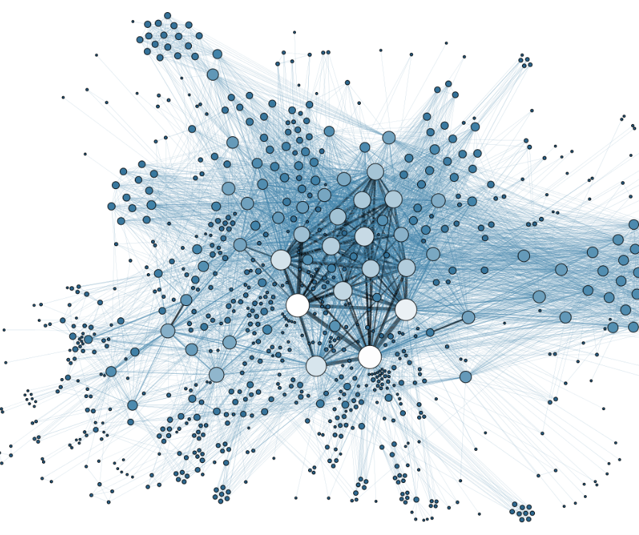
VIDEO STREAMING PERFORMACE ANALYSIS OF MANET
ENSC 427: COMMUNICATION NETWORKS
FINAL PROJECT PRESENTATION
Presented by:
TEAM 8
Enes Yazici – 301267254 (eyazici@sfu.ca)
Hardeep Takhar – 301270446 (hktakhar@sfu.ca)
Notes:
-ez

Slide 2
Roadmap
Introduction and Motivation
Overview of Related Work
Problem Description
  MANET
    History
    Benefits & Challenges
    Agenda
Riverbed Implementation
  Scenario definition
  Hardware Used & Simulation Time
  Configuration
  Results and Analysis
Future Work
Conclusion
Challenges
References

Slide 3
Roadmap
Introduction and Motivation
Overview of Related Work
Problem Description
  MANET
    History
    Benefits & Challenges
    Agenda
Riverbed Implementation
  Scenario definition
  Hardware Used & Simulation Time
  Configuration
  Results and Analysis
Future Work
Conclusion
Challenges
References

Slide 4
Motivation
Increase in mobile devices and wireless networks
Increase in the rate of video streaming usage
Providers with various technologies
Learn about infrastructure underlying video streaming tasks in MANET
Notes:
-ht

Slide 5
Introduction
What is MANET?
  Decentralized wireless network of nodes
    No infrastructure
  Each node can act as a source, a destination or a router (i.e. self configuring)
  Multi Hop network
  Mobility of nodes is not directionally restrained
Let’s discuss the Performance parameters
  No single point of failure
  Scalable network
  “Configuration on the fly”

Slide 6
Roadmap
Introduction and Motivation
Overview of Related Work
Problem Description
  MANET
    History
    Benefits & Challenges
    Agenda
Riverbed Implementation
  Scenario definition
  Hardware Used & Simulation Time
  Configuration
  Results and Analysis
Future Work
Conclusion
Challenges
References
Notes:
HT

Slide 7
Related Work
N. Rathod and N. Dongre, "MANET routing protocol performance for video streaming," 2017 International Conference on Nascent Technologies in Engineering (ICNTE), Navi Mumbai, 2017, pp. 1-5.
Discusses the performance of different MANET protocols for video streaming
Z. Zhao, S. Long and Y. Shu, "Rate Adaptive Live Video Streaming in Manets," 2006 First International Conference on Communications and Networking in China, Beijing, 2006, pp. 1-5.
Discusses factors involved in live video streaming
K. Venkatesh, N. Nithiyanandam and Sivaneshkumara, "ANFIS based QoS-aware Routing Protocol for Video Streaming in MANETS," 2019 IEEE International Conference on Intelligent Techniques in Control, Optimization and Signal Processing (INCOS), Tamilnadu, India, 2019, pp. 1-6
Discusses a QoS based protocol for improving QoS for video streaming
Notes:
HT

Slide 8
Roadmap
Introduction and Motivation
Overview of Related Work
Problem Description
  MANET
    History
    Benefits & Challenges
    Agenda
Riverbed Implementation
  Scenario definition
  Hardware Used & Simulation Time
  Configuration
  Results and Analysis
Future Work
Conclusion
Challenges
References
Notes:
HT

Slide 9
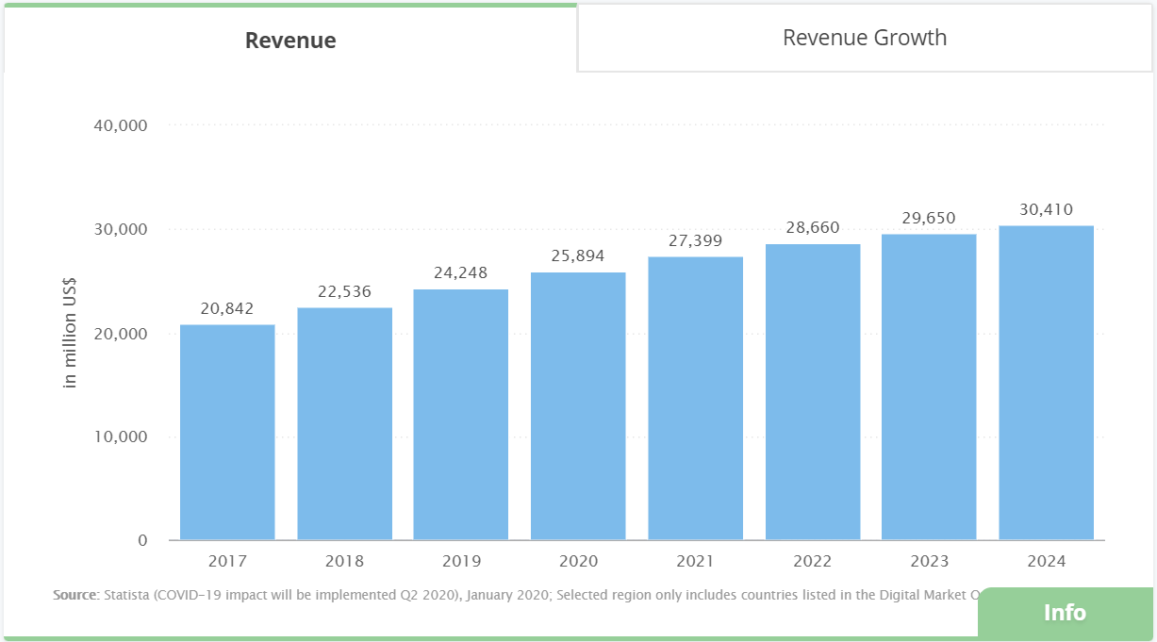
Problem Description
Revenue generation via video streaming in the US alone is US$25,894m in 2020[2]
Figure 1: Revenue generation and estimates in US from video streaming [2]
Notes:
-HT

Slide 10
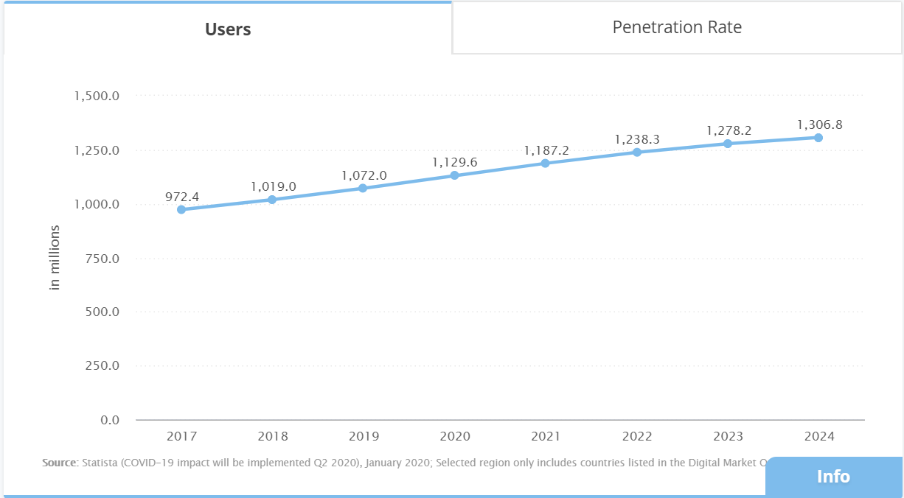
Problem Description
Number of users accessing video streaming services is ~1129.6 million users in the US[2]
Figure 2: Number of users in the US using video streaming services[2]
Notes:
HT

Slide 11
History of MANET
Three generations of MANET
  First generation in 1970s
    PRNET (Packet Radio Networks) – for military purposes
  Second generation in 1980s
    PRNET evolved into Survivable Adaptive Radio Networks (SURAN) program
    Along with ALOHA (Areal Locations of Hazardous Atmospheres) and CSMA (Carrier Sense Medium Access), PRENT’s different capabilities were tested
      Packet switched SURAN network was implemented for combat mobile environment
      Making radio communication cheaper
  Third generation in 1990s
    Commercial ad-hoc networks were conceptualized due to instream of mobile devices and laptops
    By late mid 1990s with IETF MANET was born
    Source: Bang, Ankur & Ramteke, Prabhakar. (2013). MANET: History,Challenges And Applications.
Notes:
HT

Slide 12
Benefits & Challenges
Benefits:
  Decentralized network with wireless mobile nodes
  No single point of failure
  Multiple paths from source to destination
  Multihop configuration
  Scalable
  Faster way of distributing information
  No need to define or install infrastructure

Slide 13
Benefits & Challenges
Challenges:
  Power Consumption
  Bandwidth constraints
  Interference between nodes
  Resending of data
  As no defined Infrastructure, operations need to be managed in a distributed manner
  High adaptability needed for function definitions
  Security and reliability
  Device discoverability

Slide 14
MANET
Each node works as a router
No fixed infrastructure
Stand-alone network
Extended mobility
Emergency networks
Dynamic connections
Routing Protocols
AODV
OLSR
DSR
Self-healing
Sensor Networks
Personal Area networks

Slide 15
Agenda
Intended to perform the following:
  To simulate MANET network(either using ns-3 or Riverbed Modeler)
  Feed movie traffic trace data for analysis
  Using different Routing MANET protocols compare performance of the protocol
  Using different mobility speeds and node numbers to analyse the network’s operation
Notes:
HT

Slide 16
Roadmap
Introduction and Motivation
Overview of Related Work
Problem Description
  MANET
    History
    Benefits & Challenges
    Agenda
Riverbed Implementation
  Scenario definition
  Hardware Used & Simulation Time
  Configuration
  Results and Analysis
Future Work
Conclusion
Challenges
References
Notes:
ht

Slide 17
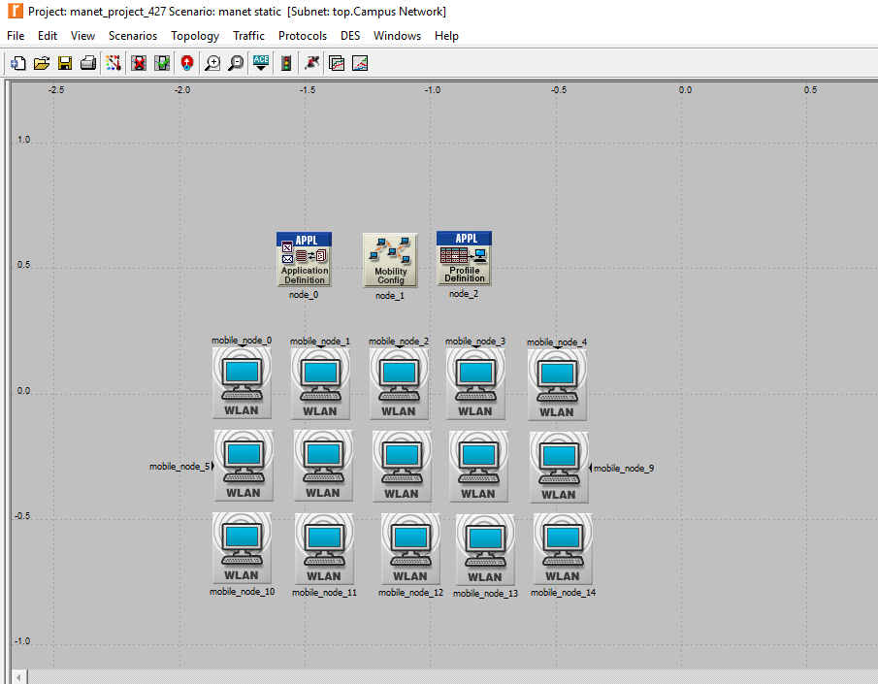
Scenarios Defination
Using Riverbed Modeler(Academic Edition-17.5), MANET of 15~20 nodes were configured to obtain data for the experiment
  2 km*2km Campus field
  Setup uses application definition, profile definition, mobility definition and mobile nodes
  Different routing protocols were used to analyze Star War’s movie’s video traffic trace data
  Different mobility speeds such as: Static (0 m/s), Less Dynamic (1 m/s), Highly dynamic (40 m/s)
Notes:
HT

Slide 18
Hardware Used & Simulation Time
For obtaining Simulation results the following Hardware was used:
  Windows-10 OS, i5 CPU (used for comparison of routing protocols)
  Windows-10 OS, Intel Pentium-CPU (used for mobility, number of nodes comparison)
For completing the simulation results on Riverbed Modeler (17.5) the time taken by the Hardware was:
  ~12 seconds for individual scenarios for static protocol performance
  ~3 minutes and 16 seconds for individual scenarios for mobility and node concentration

Slide 19
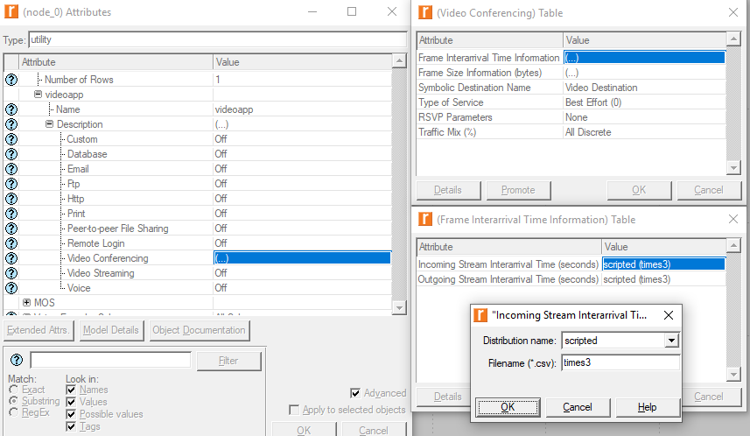
Settings used for configuring the network
Video conferencing was enabled for the application definition to input traffic trace data
Notes:
HT

Slide 20
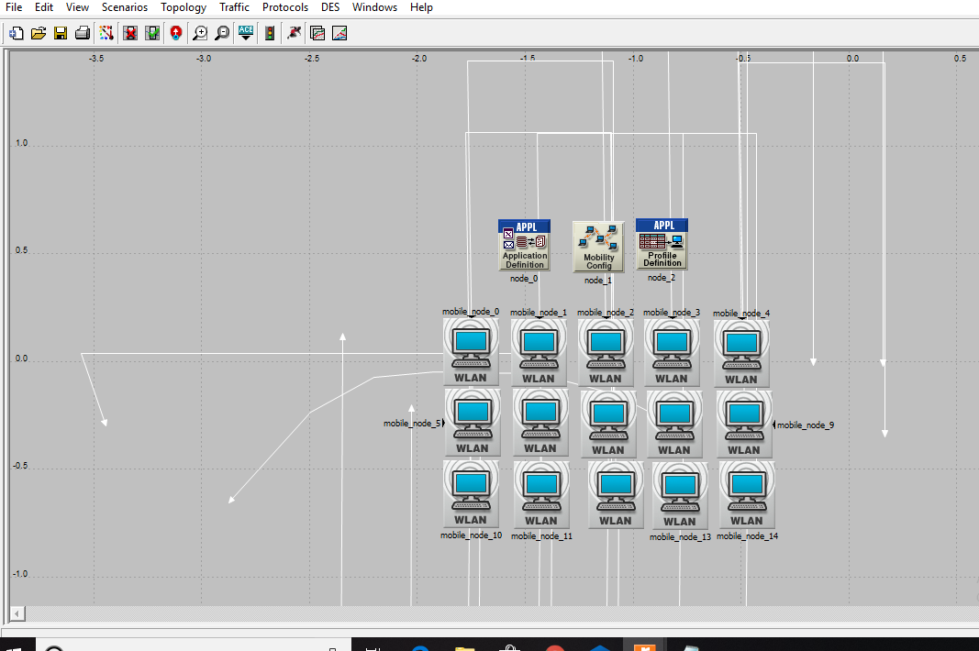
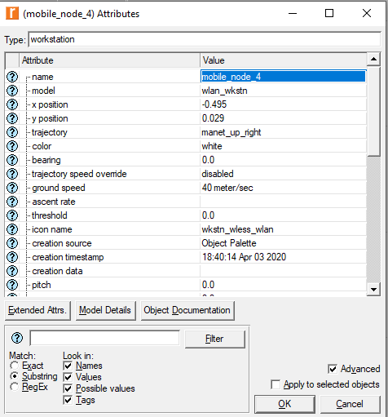
Riverbed scenarios - trajectory
15 mobile nodes with variable trajectory and ground speed used as shown
Nodes have distributed trajectory to create relative motion
Notes:
EY

Slide 21
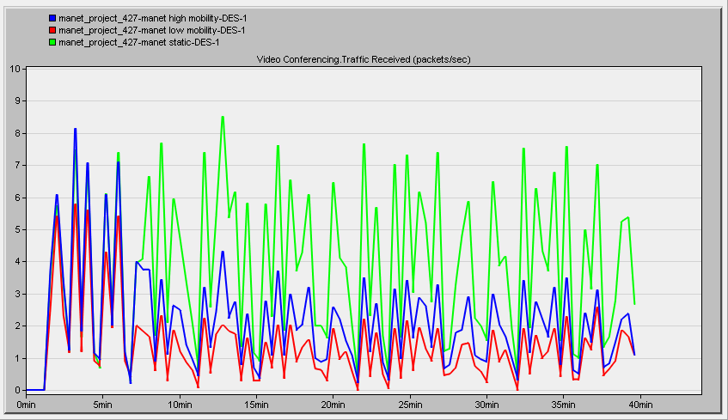
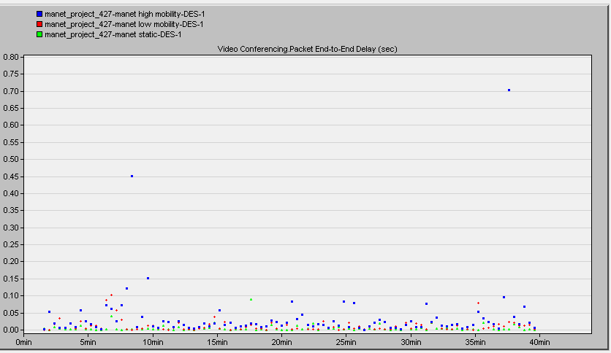
Riverbed scenarios - trajectory (Variable speeds)
AODV Traffic Received and end to end delay comparison
Notes:
EY
Addition of mobility decreases – over time receival of pkts & ; we notice high mobility performs better than low which was contrary to the expectation?
As static has highest pkts received and end2end delay is lowest for its case

Slide 22
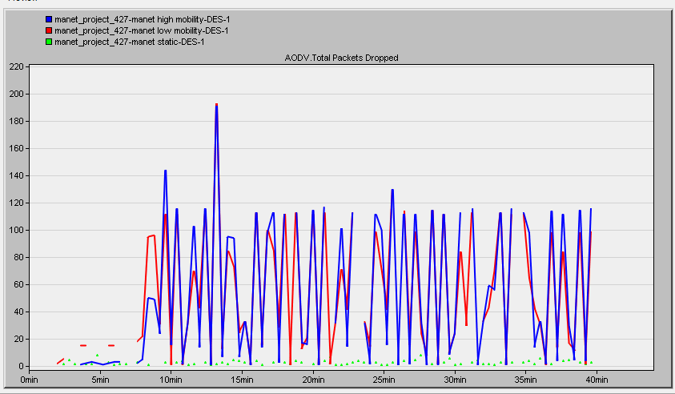
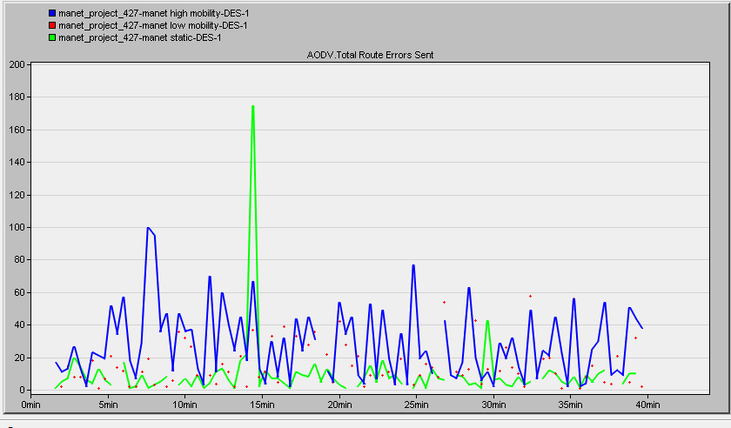
Riverbed scenarios - trajectory
AODV pkts dropped and route error sent comparison for varied mobility
Notes:
EY
Node sending hello to neighbour to test reachability if not available share info with all nodes
If mobility is high, more errors sent and more ???

Slide 23
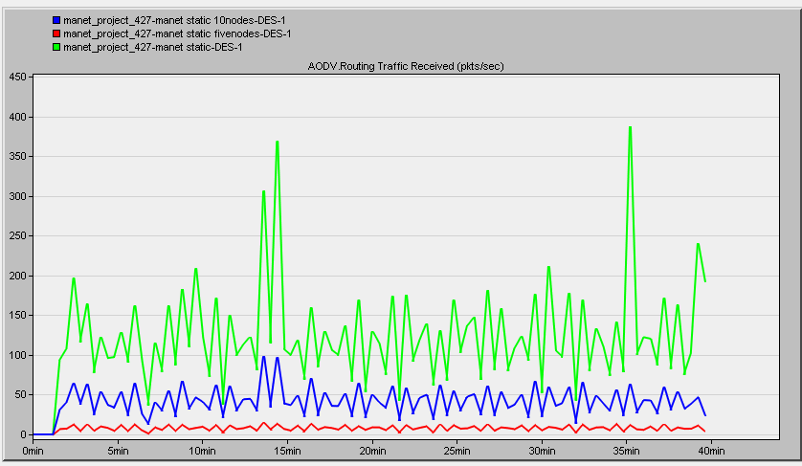
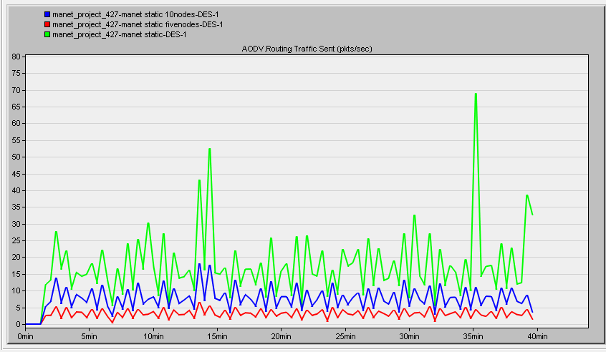
Riverbed scenarios – number of nodes
Comparing different number node performance in MANET with static mobility
Notes:
HT
green(15nodes) has highest receival and sent data ; where in blue one second highest and red with lowest(5) nodes
Compare with infrastructure network with client-server model(if more clients – server’s performace will be degraded) but better performance in MANET

Slide 24
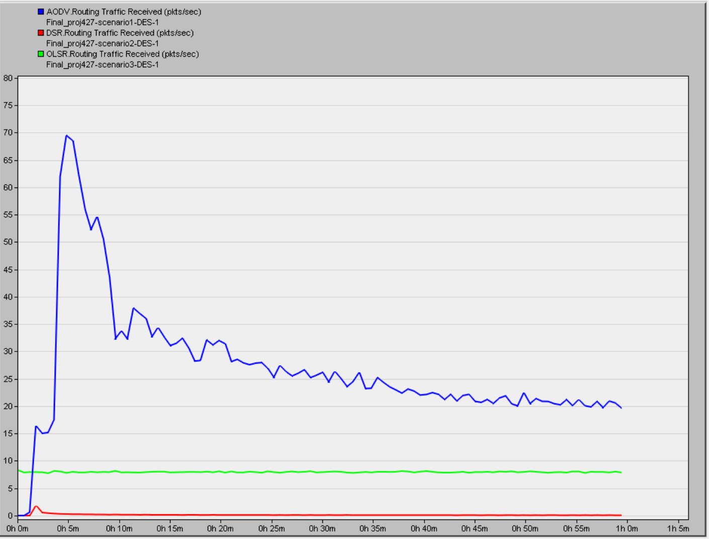
Static Simulation Results (Traffic Received)
Performance comparison for different MANET protocols
Notes:
-
HT
- Here we observed Traffic received or throughput better for AODV > OLSR>DSR

Slide 25
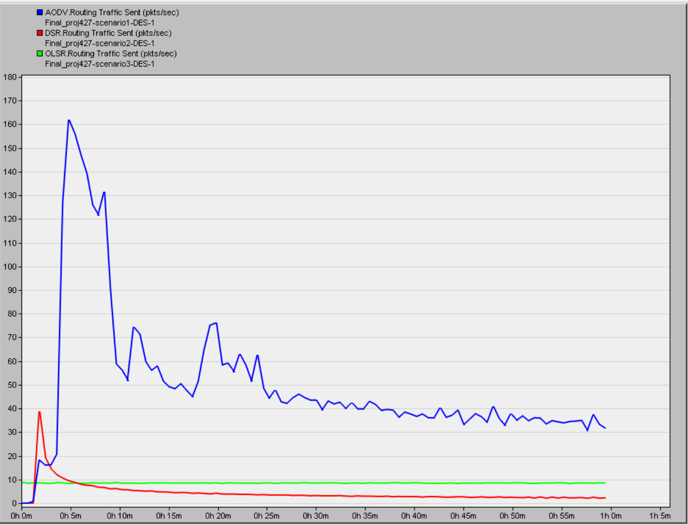
Static Simulation results (Traffic Sent)
Traffic Sent comparison for different MANET protocols
Notes:
-HT
Here we observe Traffic sent AODV>DSR>OLSR
PKT DROP IS 0 FOR DSR

Slide 26
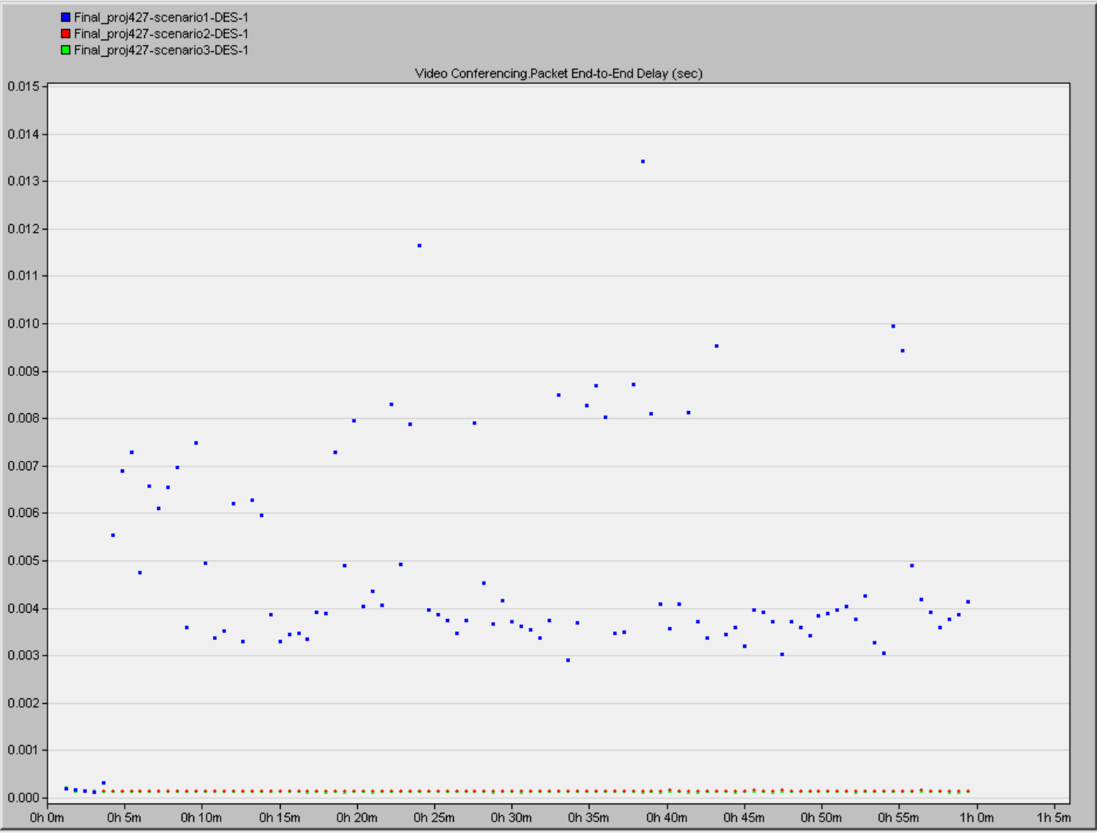
Static Simulation Results (End to end delay)
Scenario1(AODV), Scenario2(DSR), Scenario3(OLSR) – Endtoend delay comparison
Notes:
- End2delay is from Application layer perspective; - we observe High end2end delay for AODV AND same for DSR-OLSR

Slide 27
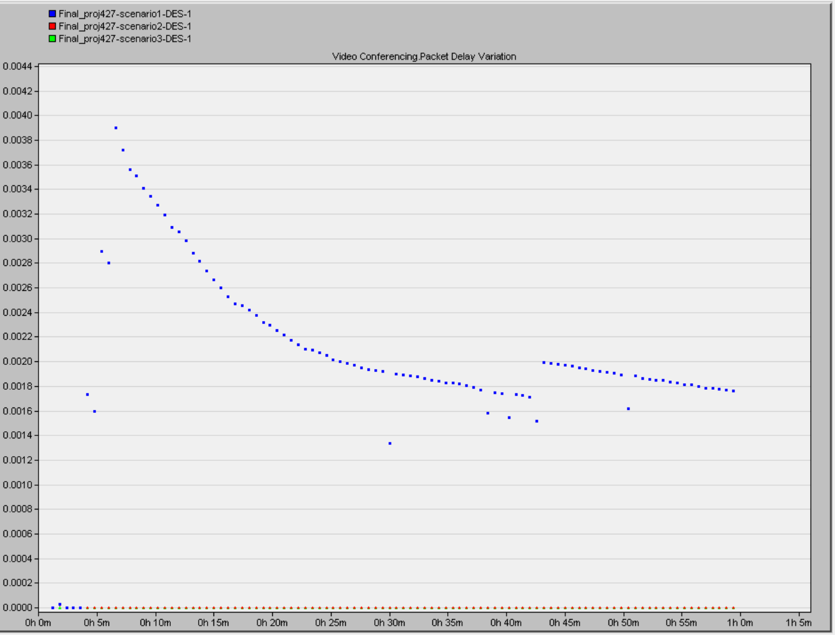
Static Simulation results (Packet Delay)
Scenario1(AODV), Scenario2(DSR), Scenario3(OLSR) – Packet delay comparison
Notes:
- High variance seen in AODV and minimal in DSR AND OLSR

Slide 28
Roadmap
Introduction and Motivation
Overview of Related Work
Problem Description
  MANET
    History
    Benefits & Challenges
    Agenda
Riverbed Implementation
  Scenario definition
  Hardware Used & Simulation Time
  Configuration
  Results and Analysis
Future Work
Conclusion
Challenges
References
Notes:
EY

Slide 29
Future Work
Simulate MANET network connecting to larger networks (eg: Internet connected network)
Simulate http video streaming
Simulate scaled network(with larger number of nodes) and wider area
Analyze live streaming traffic performance
Notes:
-EY

Slide 30
Conclusion
Increasing the speed effects:
  Packet delivery rates(decreases)
    However, high mobility performs better than low mobility which is contrary to our expectations
  Packet drop (increases)
  Route errors sent (increases)
  End to end delay (increases)
Increasing the number of nodes:
  Increases the packet sent/received rates
Routing protocols:
  Order of throughput: AODV>OLSR>DSR
  Traffic sent: AODV>DSR>OLSR
  Highest end-to-end delay for AODV, whereas low(and same) delay for OLSR and DSR
  Variance of packet delay AODV is highest and DSR, OLSR almost zero
Notes:
-EY

Slide 31
Challenges
Ns-3
  no source code for trace data
Academic Riverbed Modeler only provides limited features for analyses
Only maximum 20 nodes can be added in Riverbed modeler
Distance between nodes and the area of spanning chosen, affects the results
Notes:
HT

Slide 32
References
[1] A. K. Sharma, D. K. C. Noida and A. Mishra, "A Study of Energy Optimization for MANET," 2019 6th International Conference on Computing for Sustainable Global Development (INDIACom), New Delhi, India, 2019, pp. 264-267.
[2] “Video Streaming (SVoD) - worldwide: Statista Market Forecast,” Statista. [Online]. Available: https://www.statista.com/outlook/206/100/video-streaming--svod-/worldwide#market-revenue. [Accessed: 05-Apr-2020].
[3] Bang, Ankur & Ramteke, Prabhakar. (2013). MANET: History, Challenges And Applications
[4] N. Rathod and N. Dongre, "MANET routing protocol performance for video streaming," 2017 International Conference on Nascent Technologies in Engineering (ICNTE), Navi Mumbai, 2017, pp. 1-5.
[5] Z. Zhao, S. Long and Y. Shu, "Rate Adaptive Live Video Streaming in Manets," 2006 First International Conference on Communications and Networking in China, Beijing, 2006, pp. 1-5.
[6] K. Venkatesh, N. Nithiyanandam and Sivaneshkumara, "ANFIS based QoS-aware Routing Protocol for Video Streaming in MANETS," 2019 IEEE International Conference on Intelligent Techniques in Control, Optimization and Signal Processing (INCOS), Tamilnadu, India, 2019, pp. 1-6
[7] Sukhchandan Lally and Ljiljana Trajković, "Performance Analysis of Routing Protocols for Wireless Ad-Hoc Networks," Simon Fraser University, Vancouver, British Columbia Canada.

